Slide 1


Comparative study of various featurization and text classification methods

Slide 2
Motivation:
With the exponential growth in the enhancement of modes of information exchange, the spread of text has become not only substantially faster, but also widespread. Due to this, text has become an indispensable part of all kinds of decision making. Hence it has become imperative to analyze the methods that can help make sense of this text as efficiently as possible

Slide 3
Why are we here ?
Compared to simple topic-based classification the task of extracting meaning out of plain text and using it to train machine learning models is fairly complex
The text that is available as raw data is initially not conducive to clearly indicate what the writer wants to say and is hence not very easy to draw a conclusion out of.
The text contains a lot of noise that makes it difficult to draw sense out of. This noise is in the form of unnecessary characters, words containing numbers, and website links etc.
In this project, we shall make an attempt at analyzing the data available by discussing various tools to make the task of extracting meaning out of plain text increasingly productive.

Slide 4
What have we done?
We have taken two datasets under study, preprocessed them and analyzed the effectiveness of popular featurization models and classification algorithms when applied to the datasets
We used four different kinds of featurization techniques. These are Bag of words/N-grams, Tf-Idf vectorization, average Word2Vec and Tf-Idf Word2Vec.
On each of the data sets that come out of these feature selection methods we shall be studying the effect of 5 major classification algorithms which are K-Nearest Neighbors, Naïve Bayes, Logistic regression, Support Vector Machines and Decision Trees.
We shall be judging the effectiveness in each case by plotting the Receiver Operating Characteristic curve and checking the value of the are under the curve (ROC-AUC).

Slide 5
How have we done it?
The following slides describe how the dataset has been preprocessed and introduces us to the various feature extraction models used to obtain the vectors and the classification algorithms applied to the vectors to train the models, whose effectiveness in making accurate predictions is then analysed.

Slide 6
Text Preprocessing
The data is cleaned of noise and only relevant details are preserved that make analyzing data easier. The steps to achieve this are:

Slide 7
De-contracting words: (using ‘re’ library of python)
from “won’t” or “can’t” to “will not” or “can not”
Web link removal: (using ‘re’ library of python)
“https://www.ama.......” replaced by space
Removal of tags: (using ‘BeautifulSoup’ library of python)
tags such as “<br/>”, “<p>…</p>” are removed
Removal of words containing numbers: (using ‘re’ library)
strings like “Blue65”, “1989” are removed
Removing special characters and punctuation marks: (using ‘re’ library)
characters like “$”, “!”, etc. are removed
Stop-word removal and de-capitalization:
words like “he”, “at”, “this” are removed
“Great” changed to “great”

Slide 8
Featurization Techniques
In this section, we are explaining the various ways in which we are creating features out of our text data. It is important to understand how to convert the given text into forms from which useful information can be extracted

Slide 9
Bag of words/ N-grams
This technique involves creating a sparse vector of all the words that are present in the corpus and incrementing the count of each word occurring in a particular document, in the vector corresponding to the document, as many times as the word occurs.
In the DonorsChoose data set, the concept of n-gram also is brought into play as we have provided the parameter of ngram_range as 1-4.
This is the simplest technique for feature extraction in text classification.
the vectors can be misleading as the semantical relationship between words and the ultimate meaning of a sentence are not preserved.

Slide 10
Term frequency – Inverse Document Frequency (Tf-Idf)
Instead of the frequency of the words being present in the sparse vector corresponding to the document, a weighted frequency measure is used
The ‘Tf’ simply refers to the number times the word occurs in the concerned document. The (Idf) refers to the logarithm of the ratio between the total number of words in the corpus and the number of times the word occurs in the corpus
The importance of a word can be judged by the number of times it appears in a particular document (Tf) as well as by the rarity of the word in the corpus (Idf)
It still does not learn the contextual use of a particular word and the intrinsic sentiment of a particular sentence with considerable accuracy

Slide 11
Average Word2Vec
To help preserve the contextual meaning of a word in a particular document we use word embeddings such as weighted Word2Vec
As a part of this approach, each word is assigned a vector of reasonable dimensions (300 in our case).
To create an ‘average word2vec’ vector corresponding to each document, we sum up all the vectors of the individual words in the document and divide that by the total number of words in the same.
We have used the pre-existing ‘word2vec-GoogleNews-vectors’ repository for our purpose

Slide 12
Tf-Idf Word2Vec
This method is based on the same principle as average Word2Vec
Instead of simply adding the vectors corresponding to each word present in the document, the vectors are first multiplied with the product of term frequency and inverse document frequency and then added
The sum of the vectors is then divided by the sum of the weights for each word and what results is the final document vector

Slide 13
Classification Algorithms
Now we shall go ahead and explain the various ways in which we try to draw conclusions using the features that we now have. Each algorithm has different properties that we shall elaborate upon.

Slide 14
Hyperparameter Tuning
The ‘GridSearchCV’ algorithm, provided by the ‘sklearn.model_selection’ is used
The most suitable hyperparameter is searched out of a list that we initialize ourselves

Slide 15
K nearest neighbours classification
Given a test document x, the algorithm identifies the k-nearest neighbors to x in the training set and accordingly judges the class label of x. It is a similarity based classifier.
This algorithm is based on the similarity between instances in a particular data set. This similarity can be Euclidian/Manhattan/Cosine distance
We have used the KNeighboursClassifier provided by sklearn.neighbors

Slide 16
Naïve Bayes Classifier
This is a probabilistic classifier based on the principals of Bayes theorem and conditional probability. It assumes conditional independence between all features of the data.
The probability that a dataset X with n features is classified into class C is:
P(C/X) = P(X/C)*P(C)/P(X)
= P(x1, x2, x3, …, x4/C)*P(C)/P(X)
= P(x1/C)*P(x2/C)*…*P(xn/C)/P(X) ------------ (1)
Laplace smoothing:
P(xi/C) = (n(xi, y) + alpha)/(n(y) + alpha*k) ---------------(2)
Where, n(xi, y) = the number of times xi is present with y = 1
alpha = smoothing hyperparameter
k = number of distinct values xi can take
This classifier has been seen to perform significantly well on text data using term frequency type featurization techniques as it we get multinomially distributed data from the same.
We have made use of the MultinomialNB classifier provided by sklearn.naive_bayes.

Slide 17
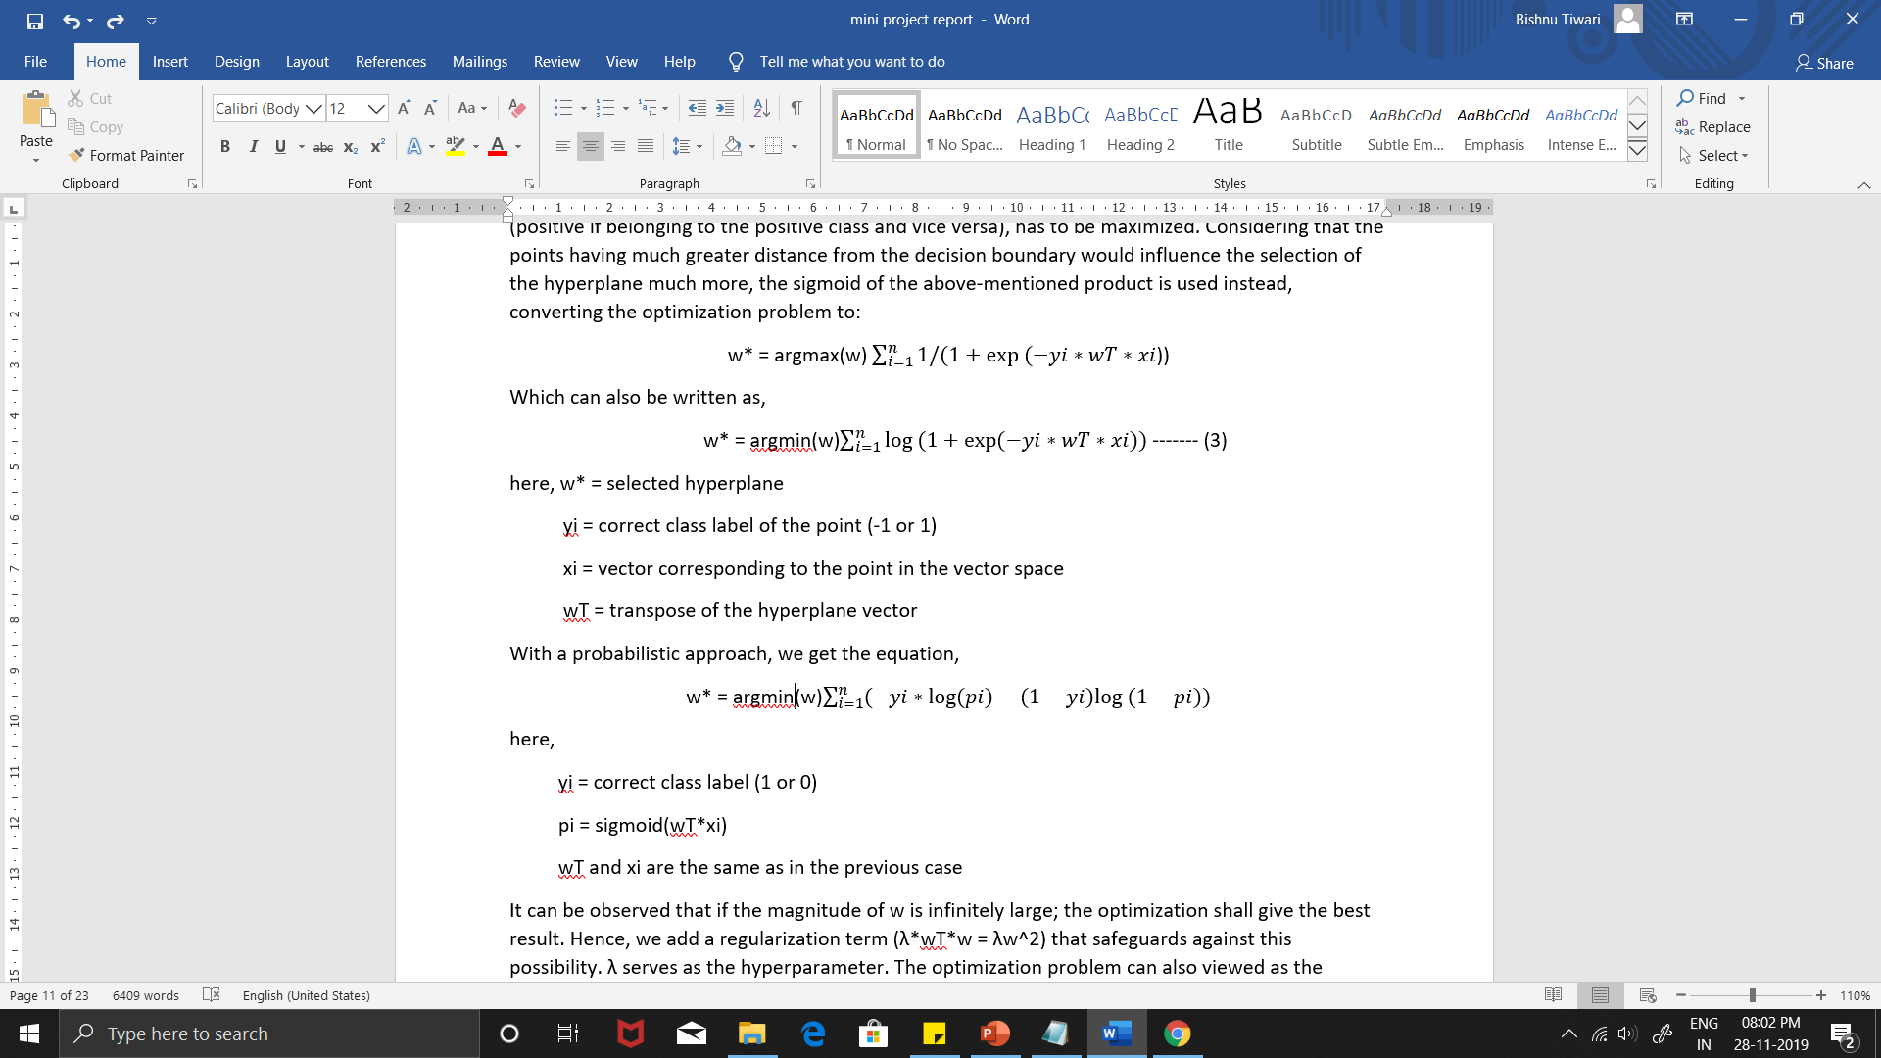
Logistic Regression
The basic idea of this algorithm is to find a hyperplane that most appropriately separates two classes from one another in the multidimensional vector space
The optimization problem can be converted to the following mathematical equations:
This algorithm automatically penalizes for the extent of misclassification and softens the effect of outliers due to the sigmoid function.

Slide 18
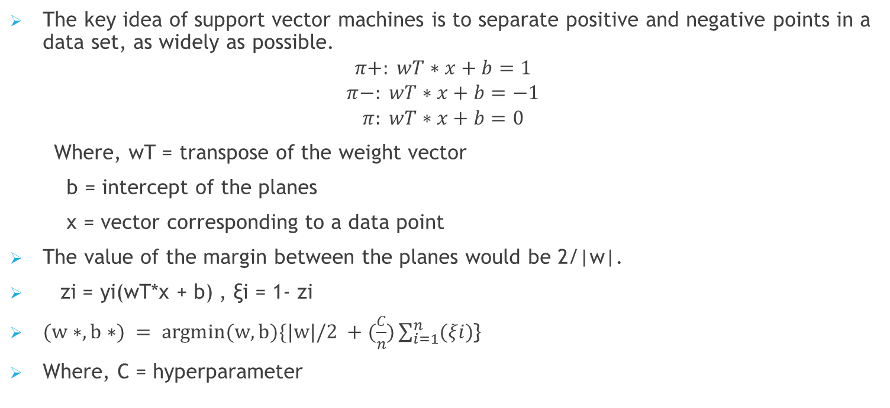
Support Vector Machines (Linear SVM)
The key idea of support vector machines is to separate positive and negative points in a data set, as widely as possible.
$$π+: wT∗x+b=1$$
$$π−: wT∗x+b=−1$$
$$π: wT∗x+b=0$$
Where, wT = transpose of the weight vector
b = intercept of the planes
x = vector corresponding to a data point
The value of the margin between the planes would be 2/|w|.
zi = yi(wT*x + b) , ξi = 1- zi
$(w∗, b∗) = argmin(w, b)\{|w|/2 +(\frac{C}{n})\sum_{i=1}^{n}{(ξi)}$}
Where, C = hyperparameter

Slide 19
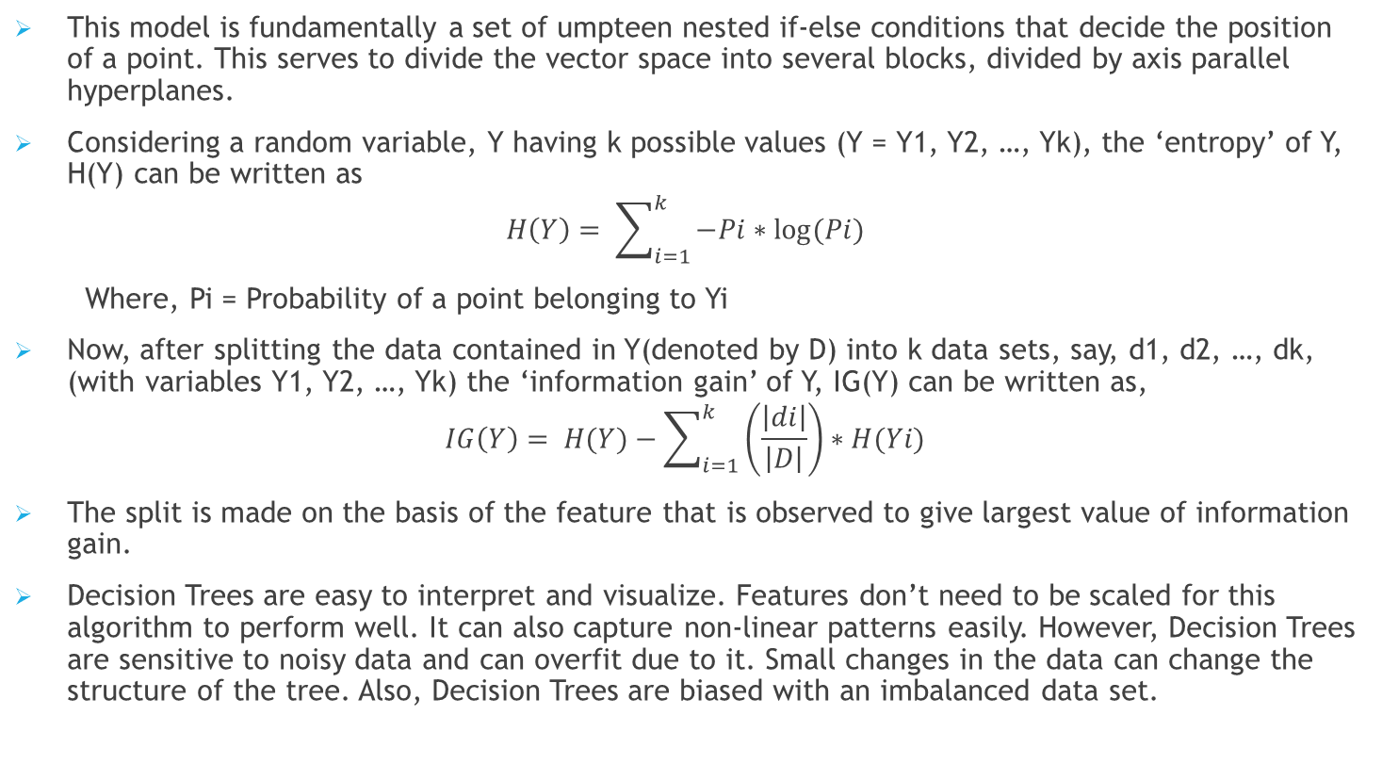
Decision Trees Classifier
This model is fundamentally a set of umpteen nested if-else conditions that decide the position of a point. This serves to divide the vector space into several blocks, divided by axis parallel hyperplanes.
Considering a random variable, Y having k possible values (Y = Y1, Y2, …, Yk), the ‘entropy’ of Y, H(Y) can be written as
$$H\left(Y\right)= \sum_{i=1 }^{k}{−Pi∗log⁡(Pi)}$$
Where, Pi = Probability of a point belonging to Yi
Now, after splitting the data contained in Y(denoted by D) into k data sets, say, d1, d2, …, dk, (with variables Y1, Y2, …, Yk) the ‘information gain’ of Y, IG(Y) can be written as,
$$IG\left(Y\right)= H(Y)−\sum_{i=1}^{k}{\left(\frac{\left|di\right|}{\left|D\right|}\right)∗H(Yi)}$$
The split is made on the basis of the feature that is observed to give largest value of information gain.
Decision Trees are easy to interpret and visualize. Features don’t need to be scaled for this algorithm to perform well. It can also capture non-linear patterns easily. However, Decision Trees are sensitive to noisy data and can overfit due to it. Small changes in the data can change the structure of the tree. Also, Decision Trees are biased with an imbalanced data set.

Slide 20
Working with the datasets

Slide 21
Amazon Fine Food Reviews
The dataset in consideration has a total of 10 attributes, out of which the most useful or relevant ones taken into consideration are: ProductId, HelpfulnessNumerator, HelpfulnessDenominator, Score, Summary, and finally, the text of the review
Step 1: Reading the data - The objective of the analysis is to determine whether a review is positive or negative, so the data is filtered based on the ‘Score’ parameter
Step 2: Data cleaning - Deduplication and garbage entries are taken care of in this step
Step 3: Text preprocessing - This step covers the section of text preprocessing, getting the data ready for use in the machine learning model
Step 4: Featurization - The dataset is now processed using the four featurization techniques – Bag of Words/N-grams, TF-IDF, Average Word2Vec and TF-IDF weighted Word2Vec
Step 5: Hyperparameter Tuning - Before applying the algorithms on a dataset, the best hyperparameter is found using GridSearchCV
Step 6: Applying the algorithms - One of the four datasets obtained in step 4 is picked and the five algorithms are applied on the datasets

Slide 22
Table for ROC-AUC values for Amazon Fine Food Reviews dataset:
Model | Featurization | Hyperparameter 1 | Hyperparameter 2 | Train auc | Test auc
SVM | TF-IDF | alpha = 0.0001 | NA | 0.998986 | 0.759983
SVM | TF-IDF Weighted W2V | alpha = 0.001 | NA | 0.741939 | 0.684694
Decision Trees | Bag of Words | max_depth = 50 | min_sample_split = 100 | 0.903586 | 0.756211
Decision Trees | Average W2V | max_depth = 5 | min_sample_split = 50 | 0.902555 | 0.770263
KNN | Average Word2Vec | n_neighbours = 50 | NA | 0.901414 | 0.863849
KNN | TF-IDF | n_neighbours = 25 | NA | 0.838038 | 0.757655
Naïve Bayes | Bag of Words | alpha = 0.1 | NA | 0.997334 | 0.881323
Naïve Bayes | TF-IDF | alpha = 0.1 | NA | 0.838038 | 0.757655
Logistic Regression | TF-IDF | alpha = 0.0001 | NA | 0.999560 | 0.946232
Logistic Regression | TF-IDF Weighted W2V | alpha = 0.001 | NA | 0.947135 | 0.900259

Slide 23
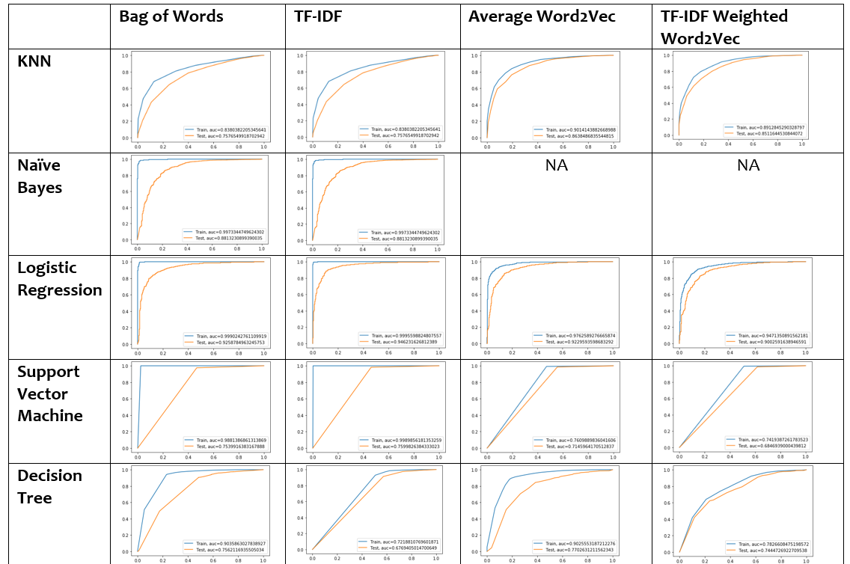
Table for ROC curves for Amazon Fine Food Reviews dataset:

Slide 24
DonorsChoose dataset
TheDonorsChoose dataset has an additional file containing the related resources required for the project corresponding to the datapoints of the train and test datasets. This dataset has both text and numerical data. There is also a vast category of attributes to be considered while handling this dataset. A detailed description of the dataset is given in the link provided above. A proper pipeline of implementation of the analysis of this dataset is broken down into steps as follows:
Step 1: The dataset is read and the categorical features are processed one by one.
Step 2: The data is now made model ready by encoding the various features and vectorizing the data.
Step 3: The dataset by now has been divided several parts representing non-text and text features, each dataset pertaining to a different attribute.
Step 4: In this step, we combine all the different features obtained into a single dataset.
Beyond this point, the datasets are processed through the different featurization techniques in consideration, and the classification algorithms are applied just as we had done is steps 4, 5 and 6 of the ‘Amazon Fine Food Reviews’ dataset.

Slide 25
Table for ROC-AUC values for DonorsChoose dataset:
Model | Featurization | Hyperparameter 1 | Hyperparameter 2 | Train auc | Test auc
SVM | Average W2V | alpha = 0.00001 | NA | 0.528594 | 0.506020
SVM | TF-IDF Weighted W2V | alpha = 0.01 | NA | 0.5 | 0.5
Decision Trees | TF-IDF Weighted W2V | max_depth = 5 | min_sample_split = 30 | 0.579191 | 0.559906
Decision Trees | Average W2V | max_depth = 10 | min_sample_split = 5 | 0.716393 | 0.562426
KNN | Bag of Words | n_neighbours = 75 | NA | 1.0 | 0.580634
KNN | TF-IDF Weighted W2V | n_neighbours = 35 | NA | 0.665354 | 0.536918
Naïve Bayes | Bag of Words | alpha = 0.001 | NA | 0.973727 | 0.601970
Naïve Bayes | TF-IDF | alpha = 0.1 | NA | 0.961296 | 0.613406
Logistic Regression | Average W2V | alpha = 0.0001 | NA | 0.724182 | 0.632226
Logistic Regression | TF-IDF Weighted W2V | alpha = 0.0001 | NA | 0.746343 | 0.637386

Slide 26
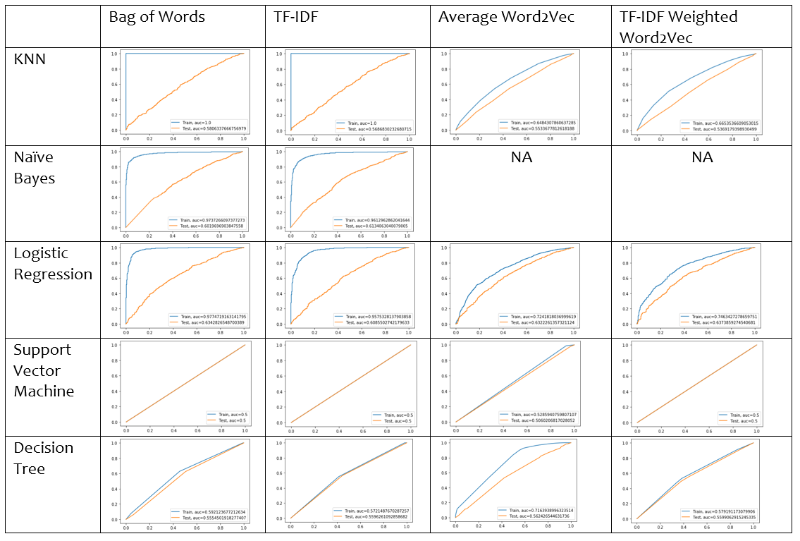
Table for ROC curves for DonorChoose dataset:

Slide 27
Conclusion
Having collated the results of the entire experiment, we observe that the most effective algorithm for both the data sets considered is Logistic Regression. In the case of the Amazon Fine Food Reviews data set, the best result is observed with the Tf-Idf featurization. In the case of the DonorsChoose data set, the best result observed with the Tf-Idf weighted Word2Vec embedding of the ‘essay’ feature. Researchers can refer to this study when applying the discussed algorithms on similar data sets containing text features. However the performance is not satisfactory and there is a need to explore newer, modern algorithms. There is a scope for the development of even newer algorithms that solve the problem a hand to a greater extent, by overcoming the limitations of the algorithms explored.

Slide 28
Thank You!

